Slide 1
AUTOMATED SUDOKU
Presented By
20E109 - HARIHARAN A
Guided By
Dr. S. KANNIMUTHU
PROFESSOR / CSE

Slide 2
INTRODUCTION
If you have a problem or you got stuck with solving sudoku, this program is just for you. This site contains Sudoku Solver a very useful application(console) which is able to solve a sudoku puzzle. The application can also generate and print sudoku.
Sudoku is a mathematical puzzle developed by the great Swiss mathematician Leonard Euler. Some say it was originally a Japanese logic puzzle but we won’t get into that.

Slide 3
PROBLEM STATEMENT
Sudoku is a mathematical puzzle developed by the great Swiss mathematician Leonard Euler. Some say it was originally a Japanese logic puzzle but we won’t get into that. We’ll concern ourselves with the project only – which is about making a Sudoku generator, as well as solver (the solving would be done by an AI-agent) Sudoku can be pretty complicated especially if puzzle has to generate based on the difficulty as that would involve using Las Vegas and also high level of genericization! The AI-part is pretty trivial but depending on your implementation and the data-structure you use, it can be difficult. For Example, it can be complicated if you define the grid as a matrix rather than an array! Note that we didn’t place Sudoku in the above category – this is because Sudoku is a single-player board game. The player plays Sudoku with himself and there is no second player in the game – meaning no possibility has to be generated at every step. There are a lot of ways you can make AI – you can simply use backtracking or you can use advanced AI methods such as constraint propagation and make use of data structures such as BST.

Slide 4
TECHNOLOGIES / LANGUAGES USED
Algorithm used: Backtracking algorithm
Language used: C programming

Slide 5
ALGORITHM DESIGN
Create a function solve that checks after assigning the current index the grid becomes unsafe or not. Keep tracking for a row, column and grid. If any number has a value 0 then assign the correct value for the cell.
Create a recursive function that takes a grid.
Check for any unassigned location.
If present then assigns a number from 1 to 9.
Check if assigning the number to current index makes the grid unsafe or not.
If safe then recursively call the function for all safe cases from 0 to 9.
If any recursive call returns true, end the loop and return true. If no recursive call returns true then return false.
If there is no unassigned location then return true.

Slide 6
IMPLEMENTATION
#include<stdio.h> #define N 9 int sudoku[N][N]; int row; int col; int cho; int isPresentInGrid(int, int, int); int isPresentInRow(int, int); int isPresentInCol(int, int); void nextStep(int, int); void solve(int, int); void print();

Slide 7
Int main() { printf(“|-----------------------------------------|\n| WELCOME TO SUDOKU SOLVER |\n|-----------------------------------------|\n| Do you want generate PUZZLE type 1 |\n|-----------------------------------------|\n| Do you want solve PUZZLE type 2 |\n|-----------------------------------------|\n| Enter any one option above 1 OR 2 |\n|-----------------------------------------|\n\n\t\t”); scanf(“%d”,&cho); printf(“\n”); if(cho==1){ srand(time(0)); sudoku[4][4]=sudoku[0][0]=sudoku[8][8]=(rand()%9)+1; solve(0,0); }

Slide 8
else { // |-----------------------------------------| |-----------------------------------------| printf(“|-----------------------------------------|\n| Enter the sudoku values to solve if, |\n| you don’t no the values enter 0 |\n| -> \n”); for(row=0;row<N;row++) { for(col=0;col<N;col++) { scanf(“%d”,&sudoku[row][col]); } } printf(“”); solve(0,0); } }

Slide 9
Int isPresentInRow(int row,int num) { for(col=0;col<N;col++) { if(sudoku[row][col]==num) { return 0 ; } } return 1; } int isPresentInCol(int col,int num) { for(row=0;row<N;row++) { if(sudoku[row][col]==num) { return 0; } } return 1; }

Slide 10
Int isPresentInGrid(int row,int col,int num) { row=(row/3)*3 ; col=(col/3)*3; int r,c; for(r=0;r<3;r++) { for(c=0;c<3;c++) { if(sudoku[row+r][col+c]==num) return 0; } } return 1; } void nextStep(int row,int col) { if(col<8) solve(row,col+1); else solve(row+1,0); }

Slide 11
Void solve(int row,int col) { if(row>8) print(); if(sudoku[row][col]!=0) nextStep(row,col); else { int val; for(val=1;val<=N;val++) { if((isPresentInRow(row,val)==1)&&(isPresentInCol(col,val)==1)&&(isPresentInGrid(row,col,val)==1)) { sudoku[row][col]=val; nextStep(row,col); } } sudoku[row][col]=0; } }

Slide 12
Void print() { printf(“\n|-----------------------------------------|\n| SUDOKU |\n”); for(row=0;row<N;row++)
{ for(col=0;col<N;col++)
{ printf(“ %d ”,sudoku[row][col]); } printf(“\n”); } printf(“| | | |\n|-----------------------------------------|\n”); getch(); }

Slide 13
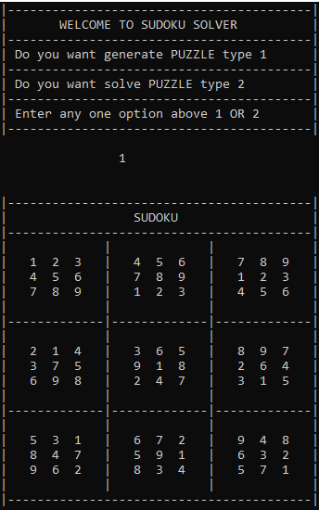
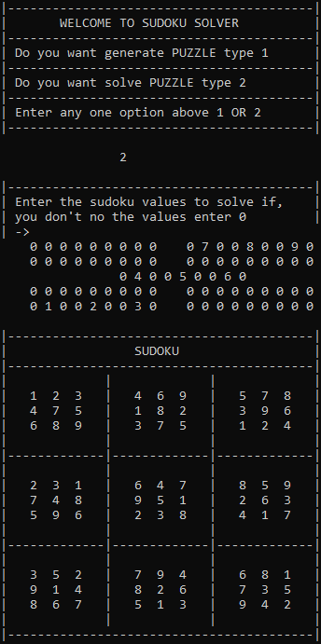
SCREENSHOTS

Slide 14
REFERENCES
https://stackoverflow.com/questions/19022739/sudoku-solver-in-c
https://www.tutorialspoint.com/sudoku-solver-in-cplusplus
https://www.geeksforgeeks.org/ backtracking-algorithms /
https://www.geeksforgeeks.org/sudoku-backtracking-7/

Slide 15
THANK YOU

